Slide 1
An Experimental Study of the Mechanical Response of Nylon-12 Tubing: Practical Implications for Use in Concentric Tube Robots
Christopher DeMaio
Notes:
Hello all, thank you for coming to my thesis defense. I’ll be presenting experimental results regarding the mechanical properties and behavior of Nylon-12 tubing and discussing how my findings apply to concentric tube robots specifically.

Slide 2
Outline
Timeline
Scope/Contributions
Background/Motivation
Methodology
Experiments/Results
Next Steps

Slide 3
Contributions
This thesis reports experimental studies on the mechanical behavior of thin Nylon-12 tubes under different loading conditions. Our evidence disproves two assumptions commonly used in the literature:
Nylon-12 tubes are purely elastic at low strains
Any deformation not immediately recovered is plastic
I propose new models, based on the theory of viscoelastic solids, that more accurately capture the time-dependent deformations experimentally observed in Nylon-12 tubes.
Notes:
In this thesis, I analyze the behavior of Nylon-12 tubing in response to various loading and unloading conditions. The evidence I collected disproves two assumptions used throughout the field of concentric tube robot research. The first assumption is that Nylon-12 tubes behave purely elastically at low strains. This means that one would expect Nylon-12 to immediately snap back to its original shape after an external load is removed from the material. The second assumption is that any deformation not immediately recovered after an external load is removed must be plastic—or permanent—deformation.
These two assumptions are key to the kinematics model used throughout the literature. By disproving these assumptions, we invalidate the model. We therefore propose a new model to more accurately capture the time-dependent deformations that Nylon-12 tubes undergo.

Slide 4
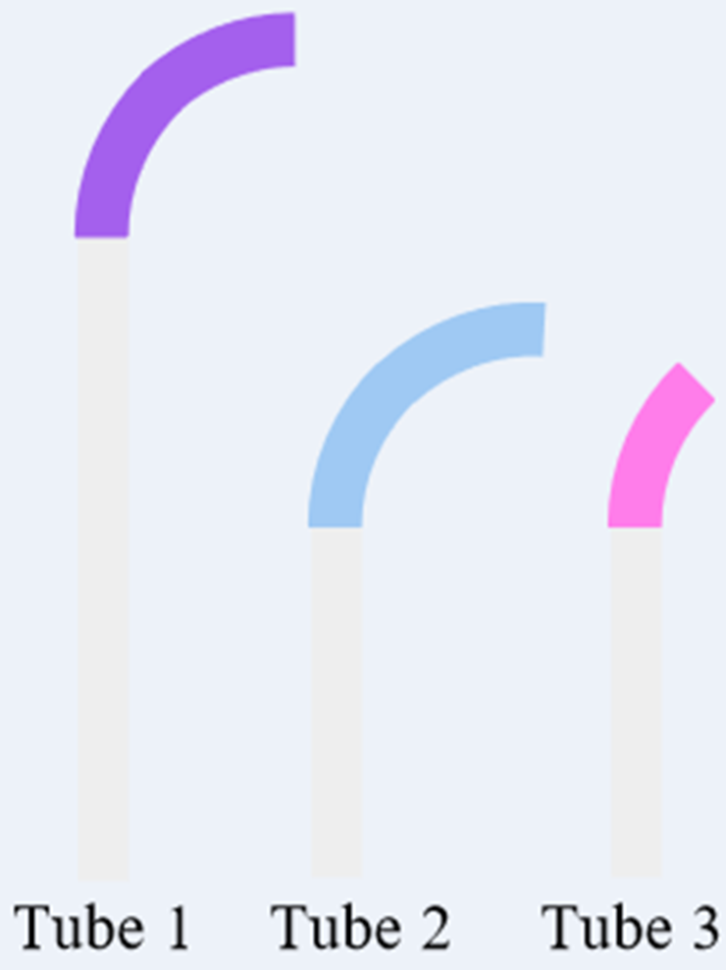
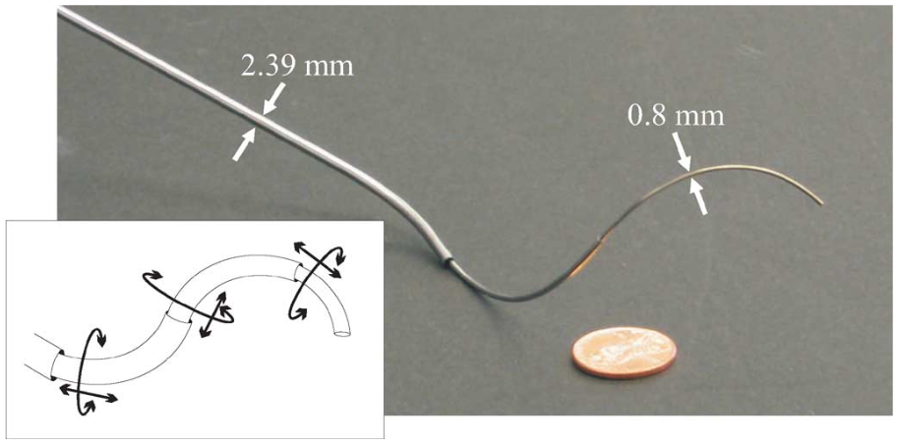
Background: Concentric Tube Robots (CTRs)
Set of pre-curved tubes nested telescopically
Miniaturizability and high dexterity enables applications in minimally invasive surgery
Notes:
While the focus of this thesis is on the material properties of Nylon-12, the motivation is in concentric tube robots, or CTRs. A CTR is a set of telescopically-nested tubes in which each tube has a long, hollow, straight section and then a curved section at the distal end. Each tube in a CTR provides two degrees of freedom: translation along the tube’s central axis and rotation about that axis. Because these robots can be actuated from the base, far from the end effector tip, they can be manufactured to incredibly small diameters, and their dexterity only increases as their size decreases. These properties make CTRs a promising option for many surgical applications.

Slide 5
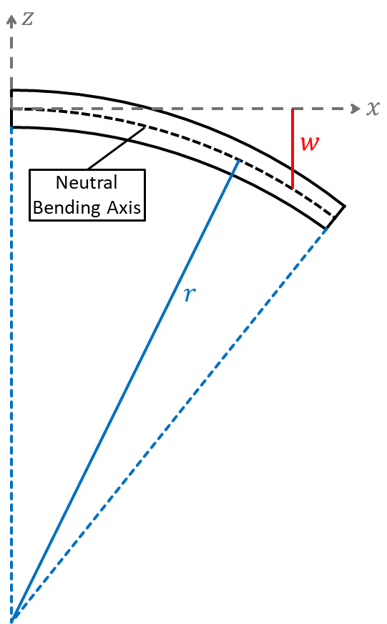
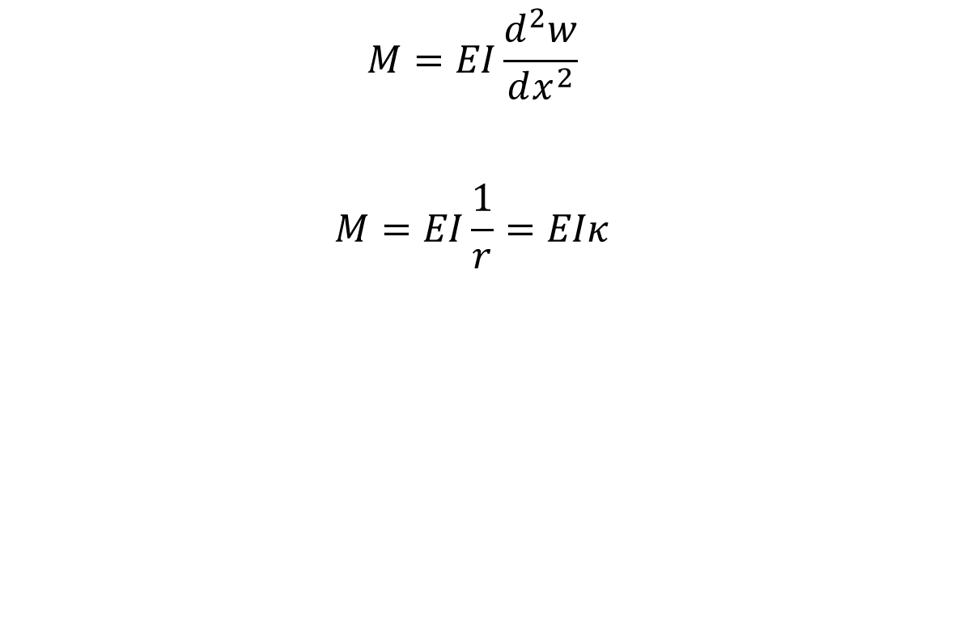
Background: CTR Modeling
$$M=EI\frac{d^{2}w}{dx^{2}}$$
$$M=EI\frac{1}{r}=EIκ$$
Notes:
The most widely used CTR models rely on the Bernoulli-Euler theory of elastic beam mechanics, which describes how beams behave when subjected to an external load. This theory relates the moment M applied to a beam to the deflection w it experiences through this equation. Here, E is the modulus of elasticity, and I is the beam’s second moment of area. If a beam’s deflection is small enough, we can approximate the second derivative of deflection with respect to x as 1 over the beam’s bending radius, or the beam’s curvature.

Slide 6
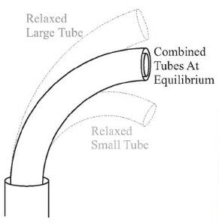

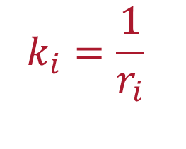
Background: CTR Modeling
Young’s Modulus
Second Moment of Area
Tube Pre-Curvature
$$k_{i}=\frac{1}{r_{i}}$$
Notes:
If we assume that a CTR’s tubes bend with constant curvature, then the moments the tubes apply to each other are constant along the length of the tubes. This assumption allows us to calculate the equilibrium curvature of a set of nested tubes as a weighted average of the tubes’ initial curvatures. In this calculation, the weights are the bending stiffnesses of each tube, defined as a product of the modulus of elasticity and the second moment of area. This elastic model of calculating equilibrium curvature is central to CTR kinematics.

Slide 7
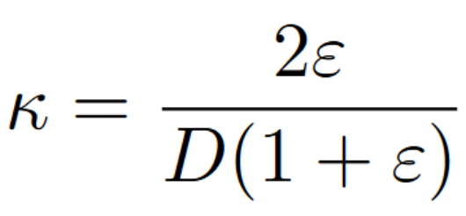
Background: CTR Modeling
Material Strain Limit
Maximum Allowable Curvature
Tube Diameter
Notes:
A key assumption of the Bernoulli-Euler model is that tubes bend elastically as long as they are not subjected to strains exceeding their material strain limit. If the tubes are subjected to strains greater than that limit, then they will undergo plastic deformation. We can use that strain limit and the tube’s geometry to calculate the maximum precurvature to which we can manufacture a tube such that the tube can be fully straightened without undergoing plastic deformation. This value is often used as a design restriction for roboticists designing CTRs, so materials with higher strain limits are generally desirable when creating CTR tubes.

Slide 8
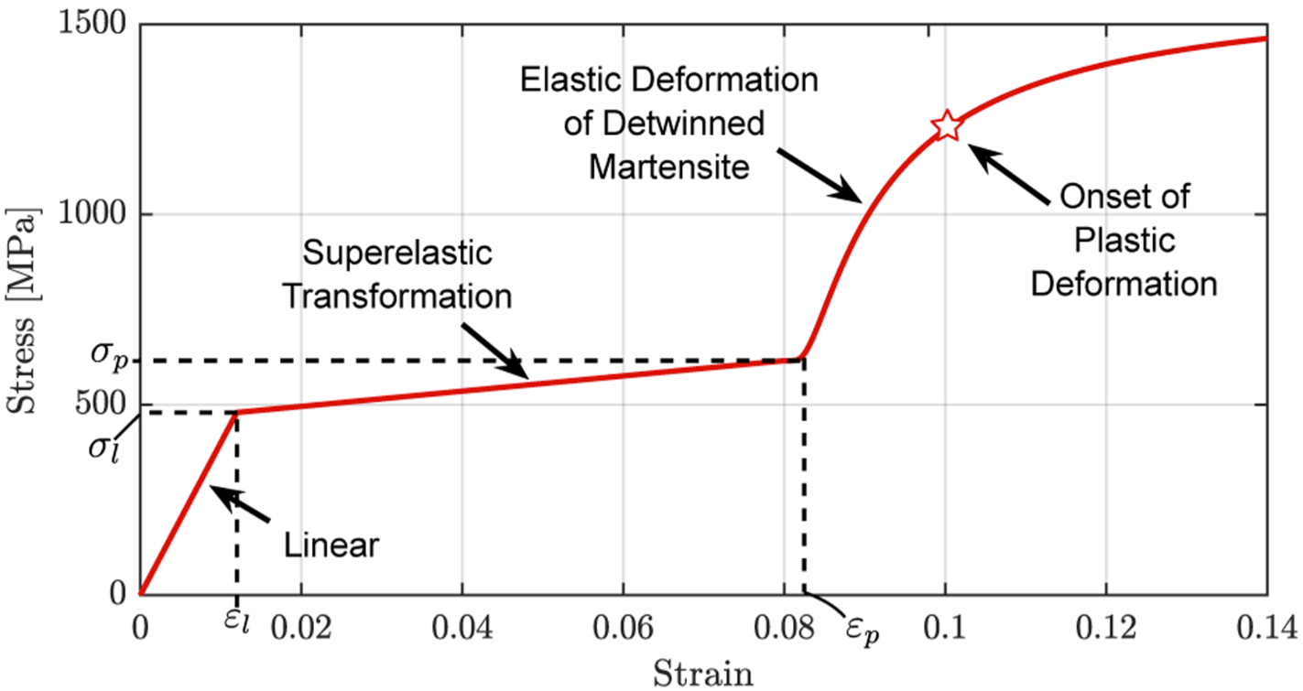
Background: CTR Tube Material
Nitinol is the material of choice for CTR tubes
  Difficult to pre-curve
  Expensive
  Long lead times
Stress-Strain Curve of Nitinol
Notes:
Most CTR researchers make their robots’ tubes out of a nickel-titanium alloy called Nitinol. Nitinol is superelastic, meaning it can undergo large strains without experiencing any permanent change to its shape. This property makes it the preferred choice for researchers designing a device to navigate the twists and turns of the human body. Despite its advantages, Nitinol remains inaccessible for many researchers. Specialized furnaces are required to curve the tubes in a process that is difficult to master and incredibly prone to error. Nitinol can be hard to acquire, as well: it can cost up to $100 per foot, and the few manufacturers who supply it have long and unpredictable lead times.

Slide 9
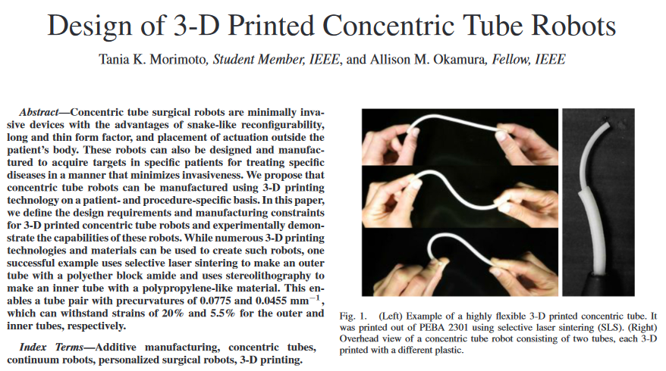
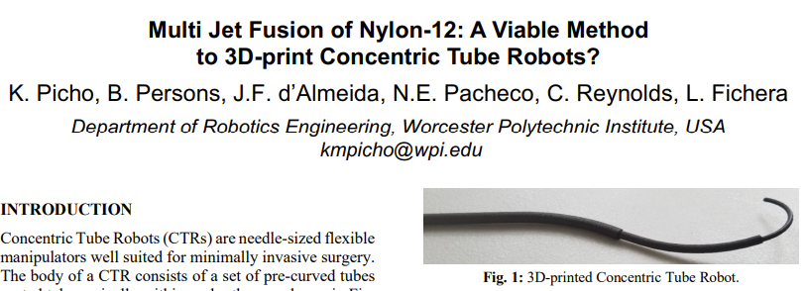
Background: CTR Tube Material
Researchers turning to plastics as a more accessible alternative
Notes:
Because of the challenges of working with Nitinol, researchers are turning to alternative materials, with various thermoplastics showing promise. Many of these plastics can be 3D printed, and others can be heat set using conventional ovens instead of the special furnaces Nitinol requires.

Slide 10
Background: CTR Fabrication
Put picture of tube molds here.
Notes:
Now I’ll go into the specifics of the heat setting process for plastic tubes. Before shaping the tube, we first need to manufacture a mold with the desired shape. We 3D printed our molds using ASA, but they can also be laser-cut out of acrylic or made using any other heat-resistant polymer.

Slide 11
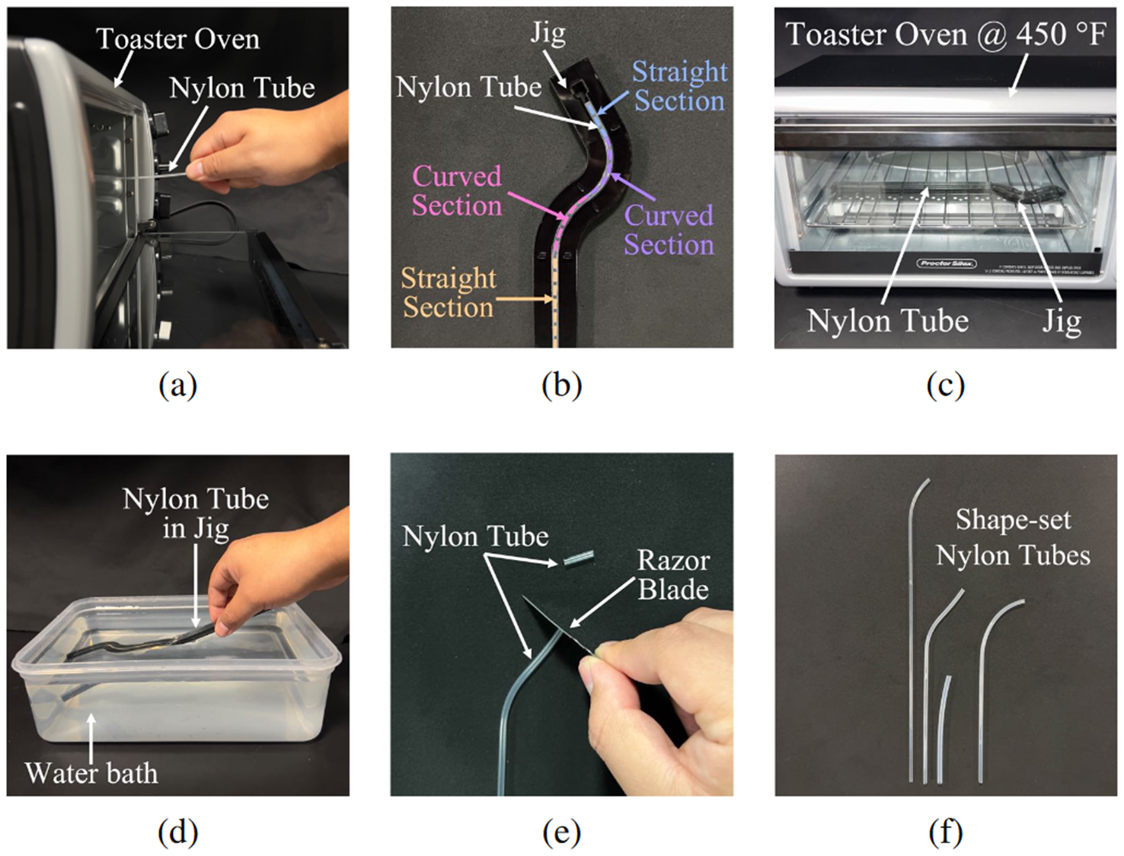
Background: CTR Fabrication
Preheat oven to 450°F.
Hold unshaped tube in oven for 10 seconds.
Place tube in heat-resistant mold and allow it to cool.
Heat the tube for 50 seconds.
Quench the tube for 110 seconds.
Allow tubes to rest for 5 minutes.
Remove the tube from the mold and cut off any excess material.
Notes:
Once we have that mold, we need an oven that can heat to 450 degrees Fahrenheit. We start by holding the unshapen tube in the oven for 10 seconds to preheat it. This makes it easier to fit the tube in the mold. After the tube cools in the mold, we place the mold in the oven for 50 seconds, and then quench it for just under two minutes in a water bath. After removing the mold from the bath, we let it rest for 5 minutes before taking the tube out and using a razor to cut off any excess material.
This procedure gives way to the first key question I sought to answer…

Slide 12
Motivation: CTR Fabrication
How repeatable is the heat-setting process for plastic CTR tubes?
Notes:
… which is, “how repeatable is the heat-setting process for plastic CTR tubes?” There have been studies analyzing the repeatability of the Nitinol manufacturing process, but no one had conducted this kind of experiment using plastic tubes.

Slide 13
Experiment 1: Heat-Setting and Relaxation
Fifteen tubes (five each of three sizes)
Nominal bending radius of 50 mm
Measured curvature at several intervals after removal from jig
Notes:
The first experiment that I’ll share with you is a study of the repeatability of this process. For this experiment, I manufactured 15 tubes using the process I just explained. I made fives tube with a diameter of 3.3 mm, five with a diameter of 2.64 mm, and five with a diameter of 1.98 mm. After making the tubes, I measured their curvatures are several time intervals in the ensuing hours and days.

Slide 14
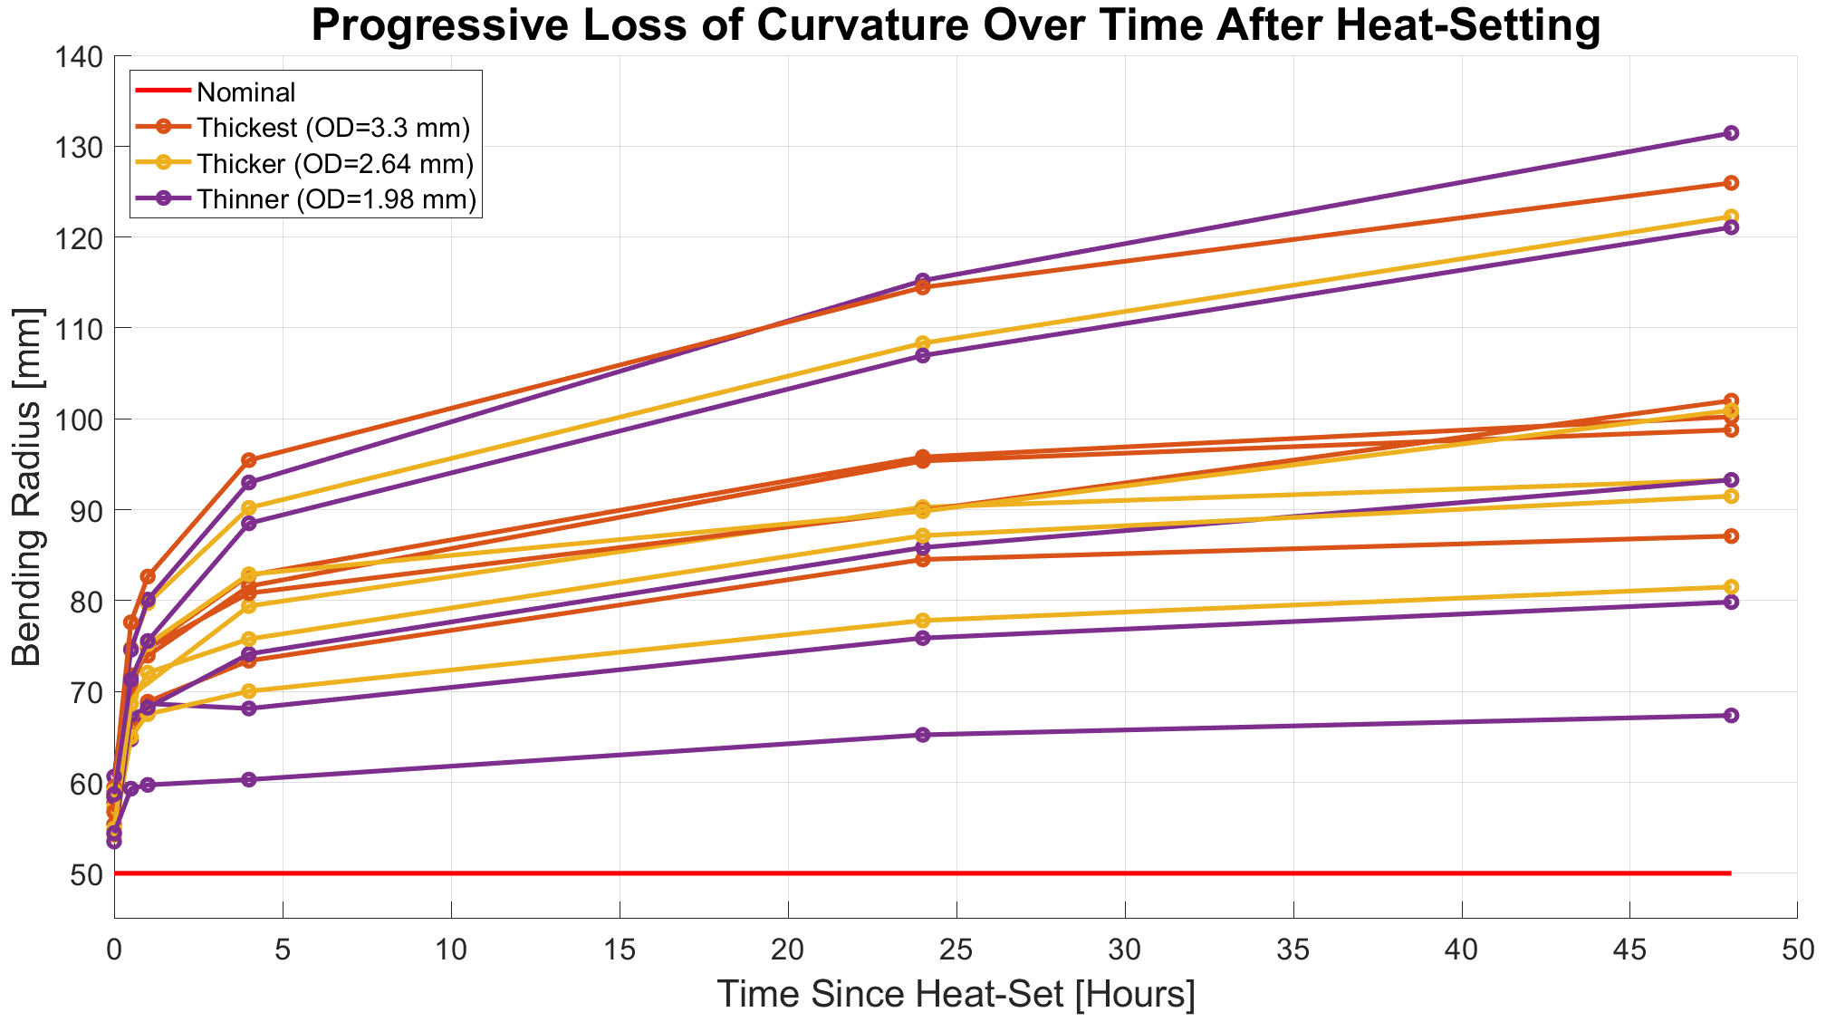
Experiment 1: Heat-Setting and Relaxation
Notes:
Here’s what I found. The red line towards the bottom of the graph represents the intended bending radius of 50 mm, and the other 15 lines each represent the bending radius of a single tube over time. There are 2 main observations we can make here.

Slide 15
Experiment 1: Heat-Setting and Relaxation
Heat-setting process has limited repeatability
Nylon-12 tubes experience increase in bending radius after removal from jig
Notes:
The first is that these tubes undergo changes in their shape in the time after they are manufactured. Every tube in this experiment experienced a significant increase in bending radius during the 48 hours after manufacturing. The second conclusion is that the heat-setting process has limited reliability. The tubes all started with similar bending radii when we took them out of the molds, but they did not end that way. We have a lot of tubes that finished with bending radii in the 80-100 mm range, but we also have tubes with radii in the 60-70 mm range, and we have a handful of tubes with radii above 120 mm.

Slide 16
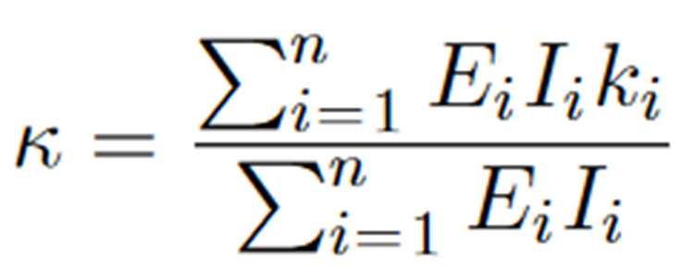
Experiment 1: Heat-Setting and Relaxation
Conclusions
Analysis
Heat-setting process has limited repeatability
Nylon-12 tubes experience increase in bending radius after removal from jig
Practitioners should measure the bending radii of plastic tubes immediately before CTR operation
This experiment suggests that Nylon-12 does not behave elastically
Notes:
From these two observations, we can draw the conclusion that practitioners should measure their plastic tubes immediately before using them in a CTR. While this step may not be necessary for Nitinol, our evidence indicates that plastic tubes relax over time, fundamentally changing their geometry.
This experiment also suggests that Nylon-12 does not behave elastically. If Nylon-12 were perfectly elastic, the tubes would not have experienced the gradual relaxation that they did. Instead, any relaxation should have occurred instantaneously. This distinction is important because the model widely used by CTR researchers to calculate CTR kinematics depends on the assumption that a CTR’s tubes are elastic. This discrepancy serves as the motivation for my second experiment…

Slide 17
Experiment 2: In-Plane Bending
Motivating Question
Does the elastic model, which correctly describes Nitinol tubes, accurately predict the equilibrium curvature of Nylon-12 tubes?
Notes:
… in which I sought to answer whether the elastic model for calculating equilibrium curvatures would work for Nylon-12 tubes.

Slide 18
Experiment 2: In-Plane Bending
Nested five sets of tubes
Measured curvature at several intervals over ensuing 30 minutes
Compared to elastic model
Notes:
For this experiment, I produced five curved Nylon-12 tubes of diameter 2.64 mm, and inside those tubes I nested straight Nylon-12 tubes of diameter 1.98 mm. I measured the equilibrium curvatures at several time intervals in the ensuing 30 minutes before separating the tubes. I compared the measured curvatures with the ones predicted by the elastic model.

Slide 19

Experiment 2: In-Plane Bending
There will be a relevant graph here.
Eventually.
Notes:
The results show… <something>.

Slide 20
Experiment 2: In-Plane Bending
Conclusions
Motivating Question
Equilibrium curvature changes over time
Elastic model does not capture behavior of Nylon-12 tubes
Are our assumptions about Nylon-12 valid?
Notes:
This experiment indicates that the elastic model fails to capture the behavior of Nylon-12 tubes. This led me to dig another step deeper and test the key assumptions researchers make about Nylon-12 tubes. Are the tubes truly elastic at low strains? When tubes return to their initial configuration after being deformed, do they do so instantly?

Slide 21
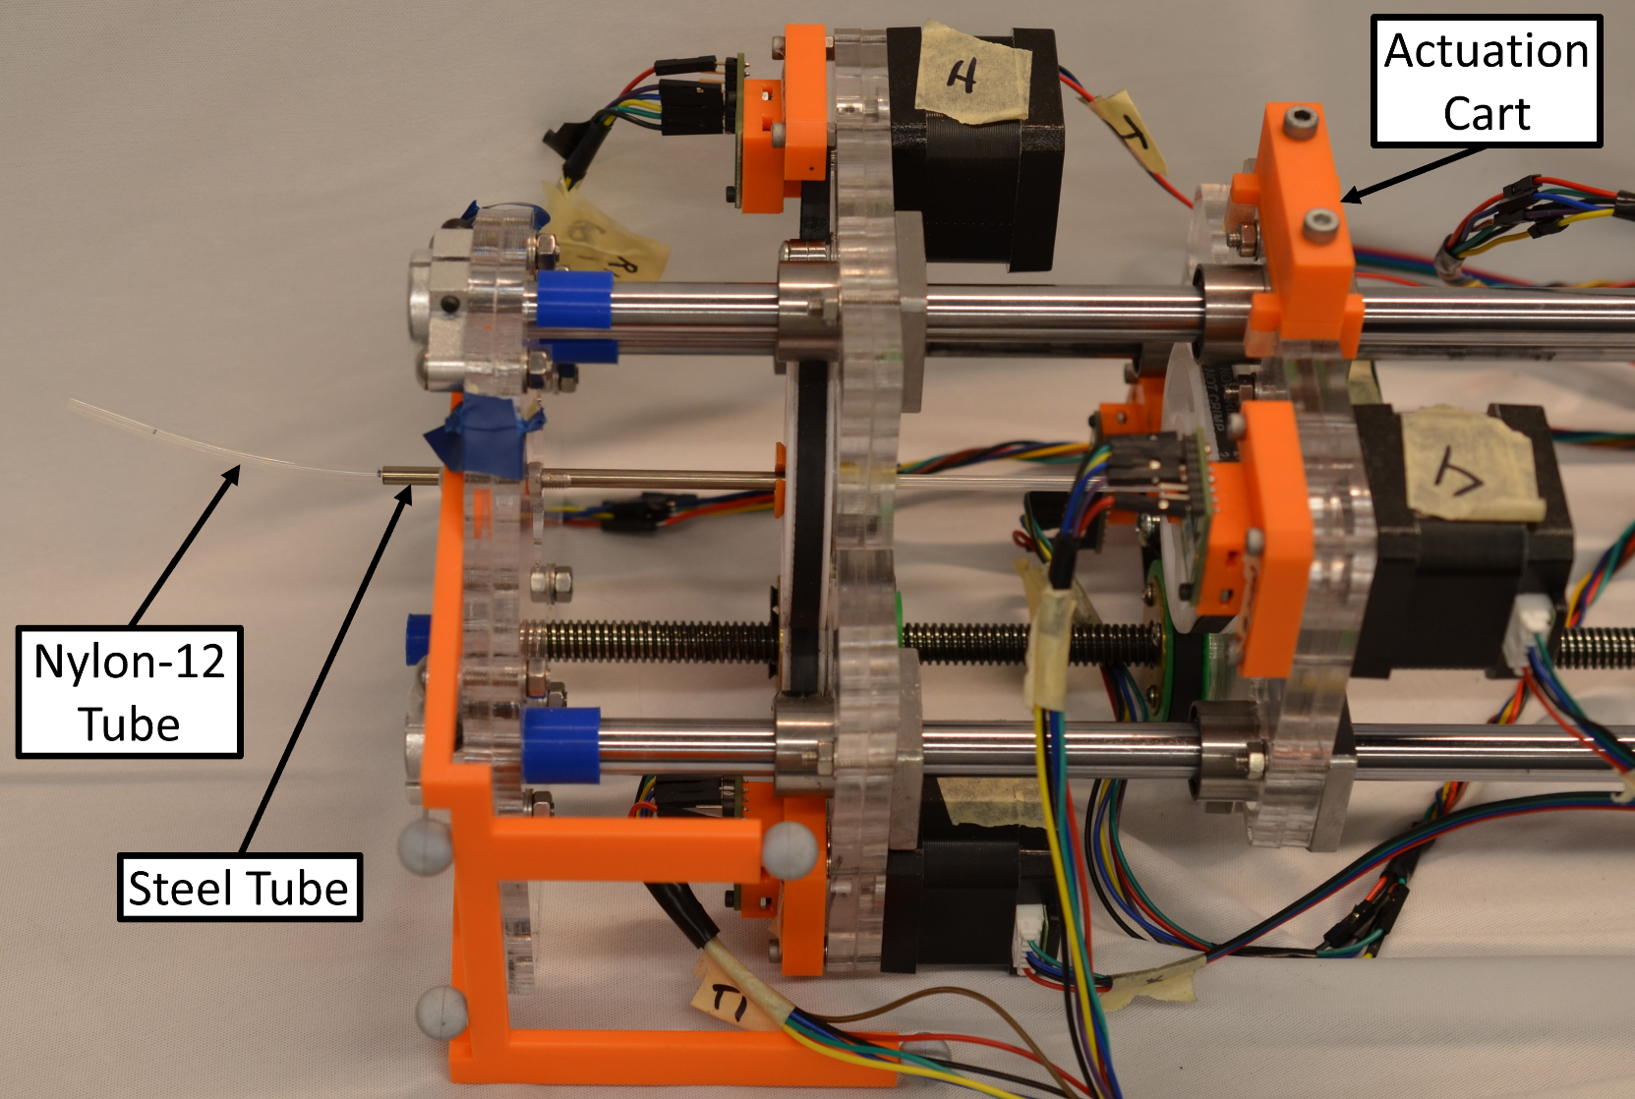
Experiment 3: Repeated Straightening
Repeatedly straightened 15 tubes from Experiment 1
Measured curvature:
  Every 5 cycles, up to 30
  3 days after experiment
All curvatures below maximum allowable
If tubes are elastic, curvature should not change
Notes:
To answer these questions, I repeatedly straightened the 15 tubes I produced for the first experiment by pulling them into a steel tube and pushing them back out. I did this 30 times for each tube, pausing to measure the tube’s bending radius after every 5 straightening cycles. I also measured the curvatures three days after straightening the tubes. If the assumption that the tubes are elastic holds, then we should expect that the tubes’ curvatures do not change throughout the experiment.

Slide 22

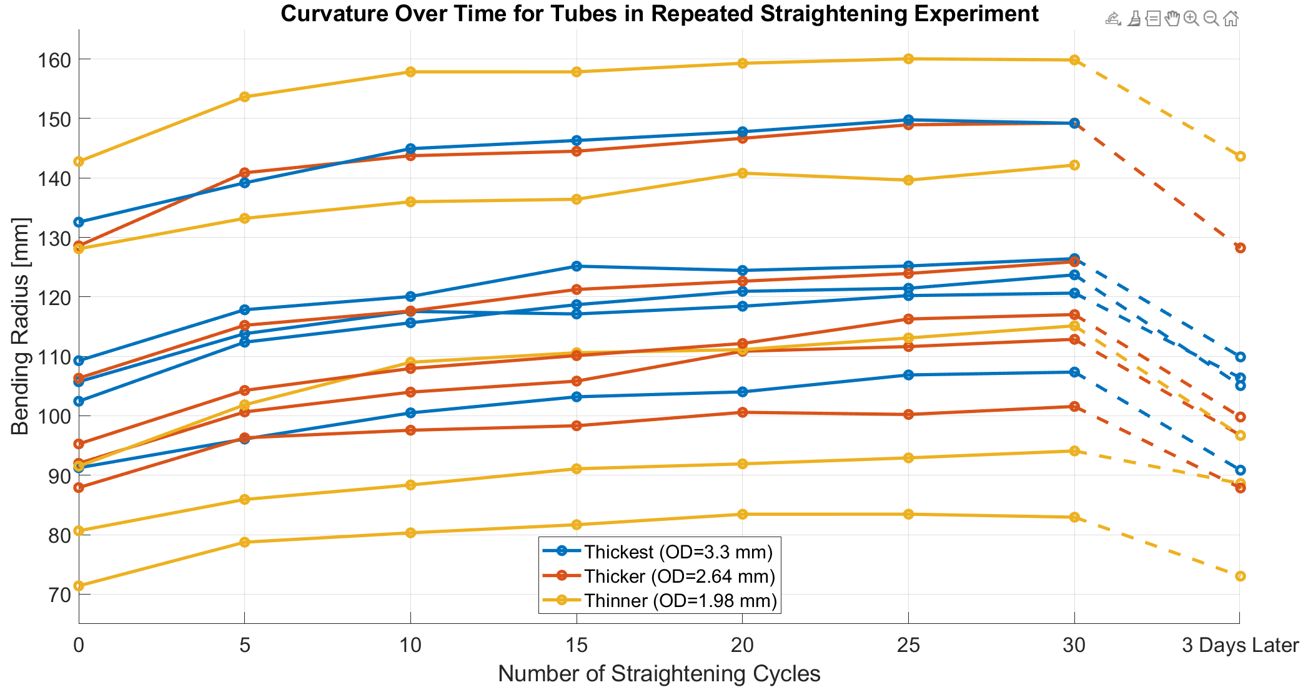
Experiment 3: Repeated Straightening
Notes:
The results show… <something>.

Slide 23
Experiment 3: Repeated Straightening
Conclusions
Tubes are not purely elastic, even at low strains
Tube deformation is not plastic
Tubes behave viscously
Prior assumptions do not hold for Nylon-12; elastic model disproven
Notes:
We can conclude from this experiment that the tubes do not behave as purely elastic materials, even at low strains. But the fact that they recover their curvatures shows that they don’t behave as purely plastic materials either. This suggests that the tubes are instead viscoelastic, with both deformation under a load and recovery after unloading being gradual rather than instantaneous.

Slide 24
Experiment 4: Unloading Response
Fifteen tubes (five each of three sizes)
Nominal bending radius of 50 mm
Measured curvature at several intervals after removal from jig

Slide 25
Experiment 4: Unloading Response
There will be a relevant graph here.
Eventually.
Notes:
The results show… <something>.

Slide 26
An Experimental Study of the Mechanical Response of Nylon-12 Tubing: Practical Implications for Use in Concentric Tube Robots
Christopher DeMaio

